Slide 1
Fraud Analytics Dashboard

Slide 2
Summary
Looked at the transactions of a bank from 10 am to 11 am
1000 transactions were broken down to fraudulent attempts based on transaction type, status, network slice, device type and location
Also built drill through to see the details of the transactions when hovered on the charts
Built a predictive analysis by breaking down the hourly data into 2 chunks of 30 mins to predict the pattern for the next 30 mins.

Slide 3
Key Insights
Nearly half of total transactions result in Fraud and close to 50% are successful attempts.
55% fraudulent transactions are on mobile.
We see a higher concentration of frauds during the middle of the bandwidth of 100-150 Mbps.
One third of the fraud activities take place in US and Russia.
Total amount lost is around $183K. Lowest fraudulent amount has been $54.96 and highest is $1497.76

Slide 4
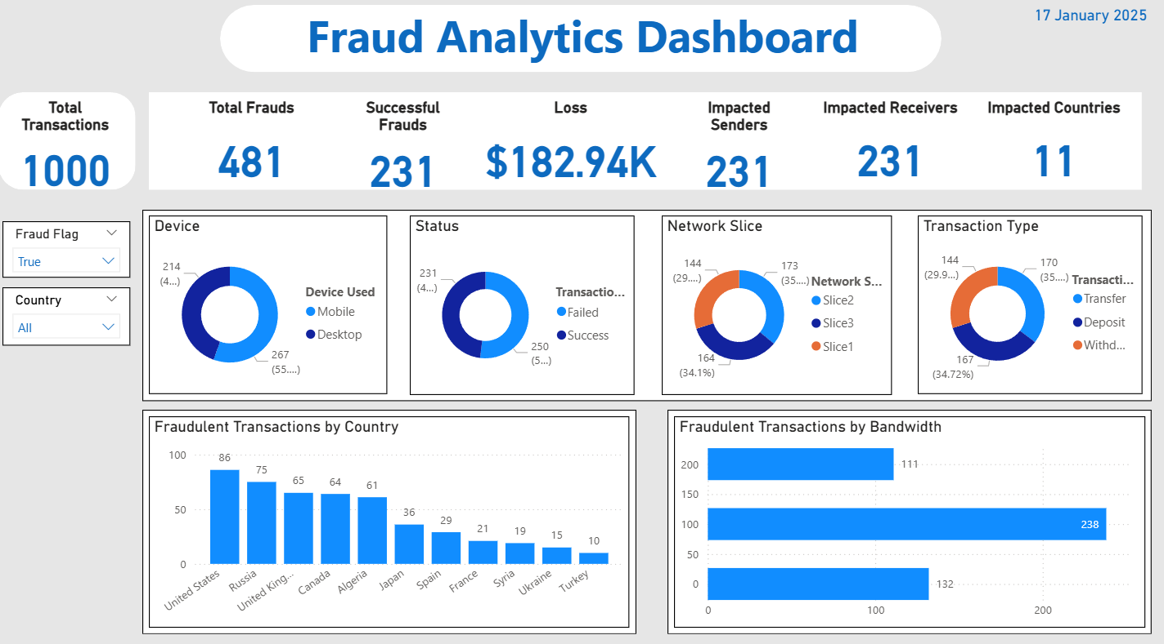
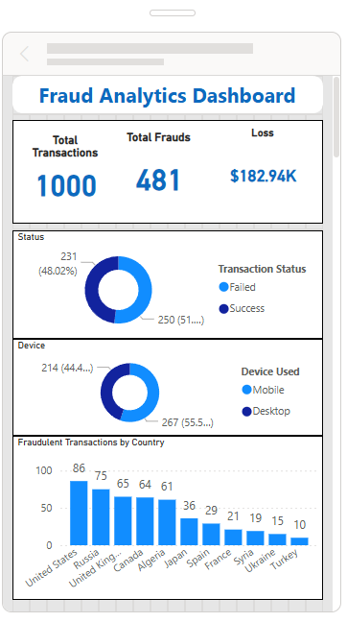
Desktop View
Mobile View

Slide 5
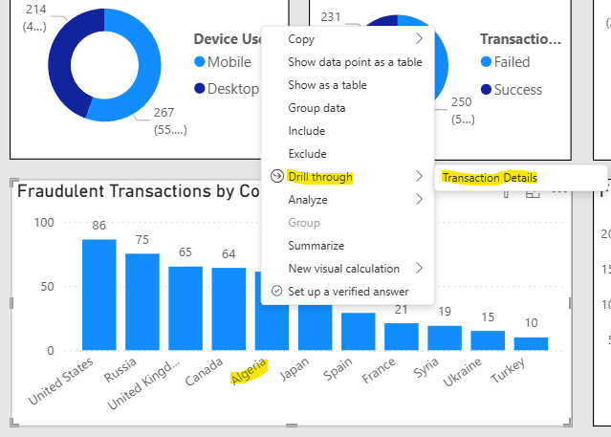
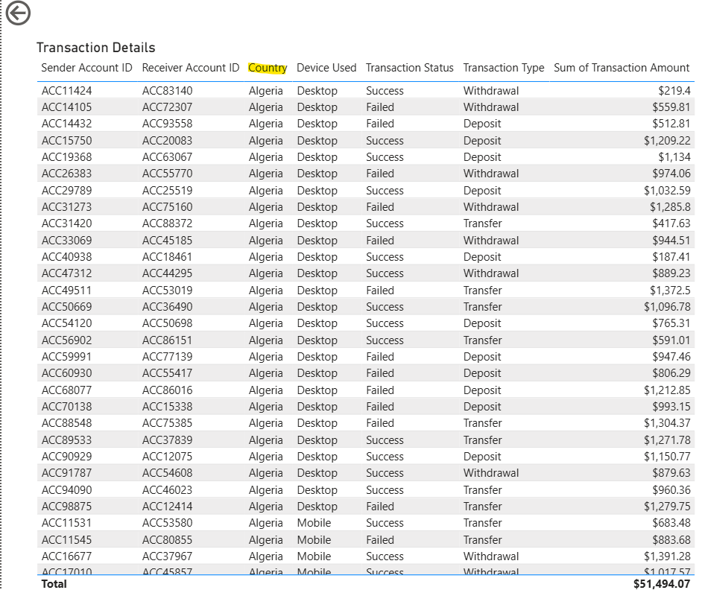
Details
On drill through on the transactions by country chart on Algeria, it’ll take the user to the transaction details page with data only for Algeria.

Slide 6
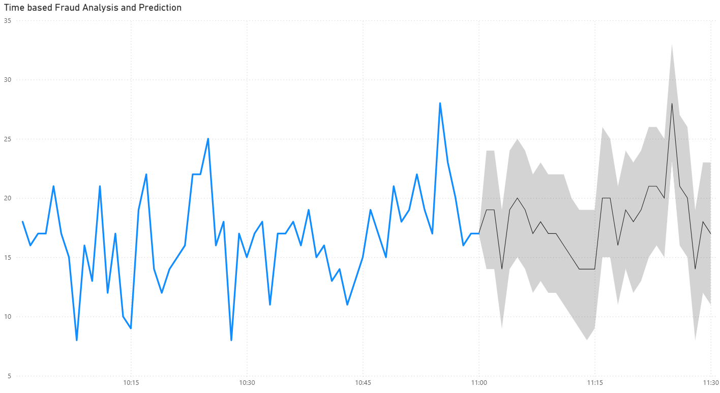
Prediction
Since we only have 1 hour’s data, it was broken down to 30 min chunks to analyze the behavior for the next 30 mins. We are seeing a spike at 11:20 am.

